Slide 1
1.6 million UK traffic accidents
Visualise and analyse traffic demographics
Alger Remirata
Data Scientist

Slide 2
The Rationale
Engineers and researchers in the automobile industry have tried to design and build safer automobiles, but traffic accidents are unavoidable. Patterns involved in dangerous crashes could be detected if we develop a prediction model that automatically classifies the type of injury severity of various traffic accidents. These behavioral and roadway patterns are useful in the development of traffic safety control policy.
Road accidents are never a happy issue to discuss. It not only has severe consequences for those involved, it also affects the lives of many others like friends and family. With more vehicles on the road than ever before, its important to understand them in greater detail, and possibly ‘predict’ the locations and consequences of these accidents. Government agencies in the UK have been collecting data about the accidents that were reported since the year 2005. The data includes generic and specific details about the vehicles, driver, number of passengers and number of casualties.

Slide 3
Goal
Key Business Problems:
Can we identify and quantify associations between number of casualties and other variables in a road accident?
Explore whether it is possible to predict accident hot-spots based on the data.
Possible Stakeholders:
Policy-making agencies like the government
Engineers and researchers in the automobile industry
Freight transportation company and other companies providing international courier, parcel and express mail services.

Slide 4
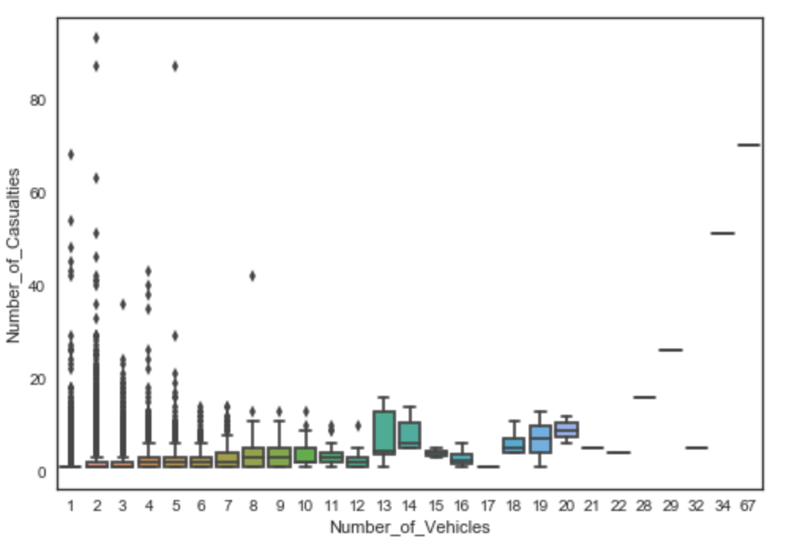
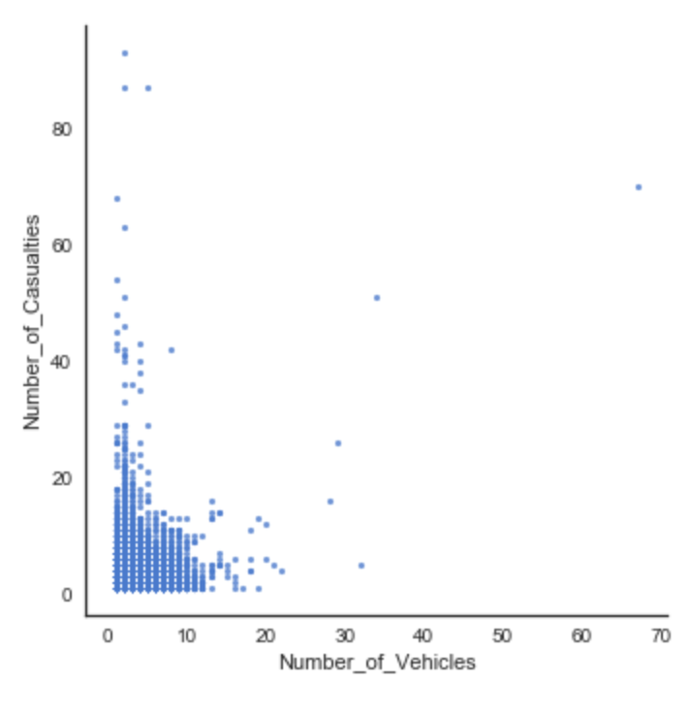
Exploratory Data Analysis
Question: If we have more vehicles involved in the accident, do we have more casualties?

Slide 5
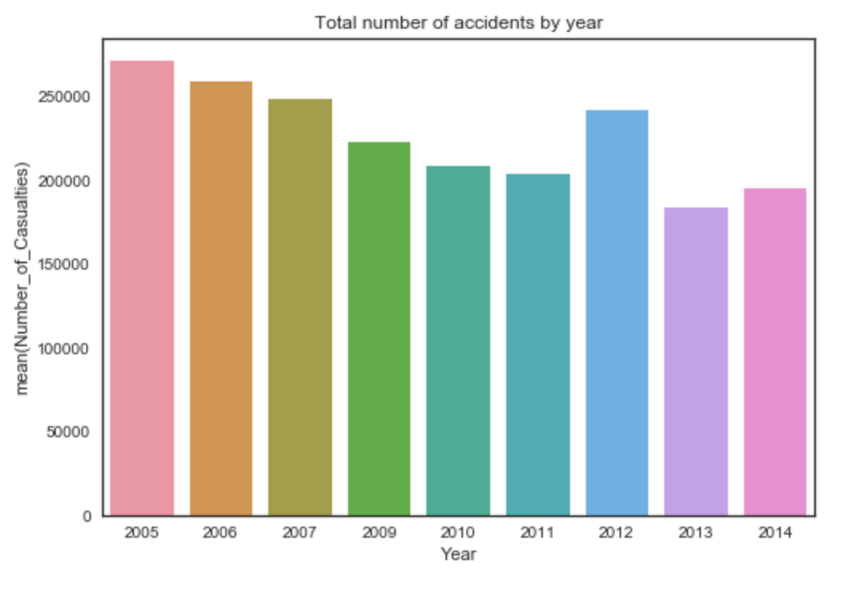
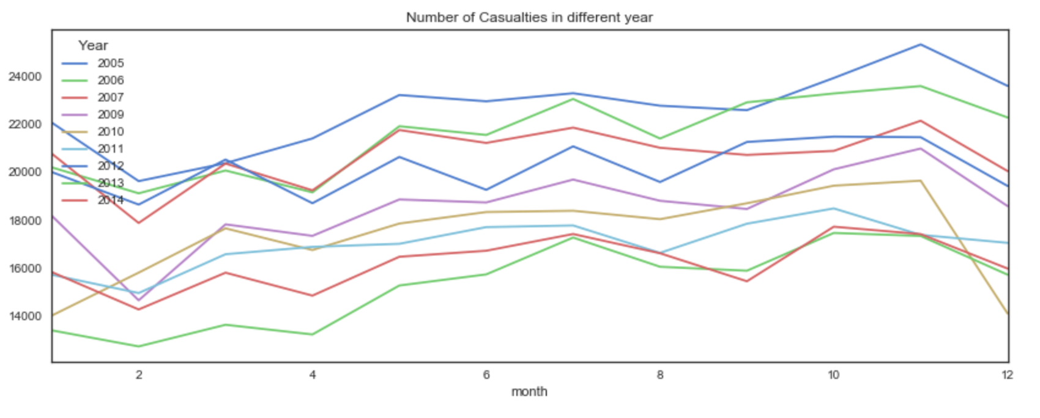
Exploratory Data Analysis
Question: In which year we have more casualties in road accidents? Does the number of casualties increase or decrease?

Slide 6
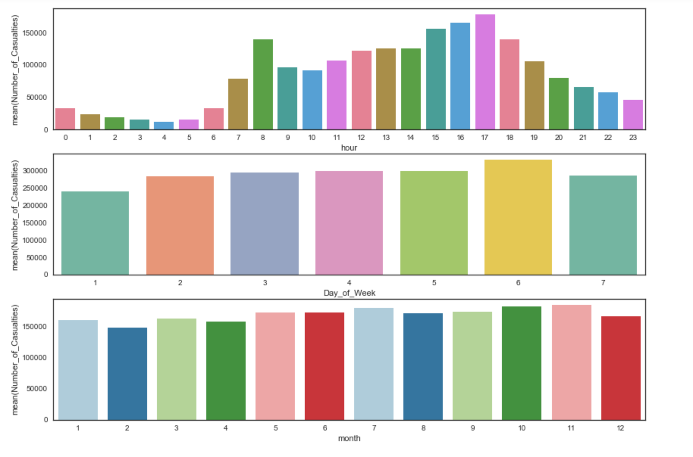
Exploratory Data Analysis
Question: What time of the day we have more accidents happening? What day of the week? What month can we see an increase in the number of road accidents happening?

Slide 7
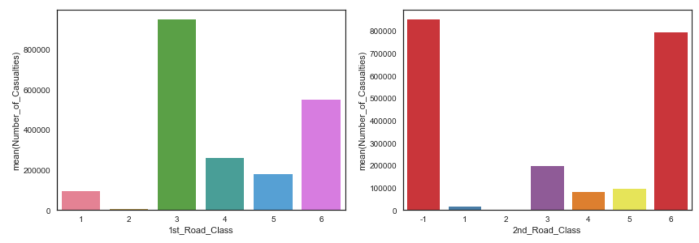
Exploratory Data Analysis
Question: Is there specific class of roads accidents happen more frequently?

Slide 8
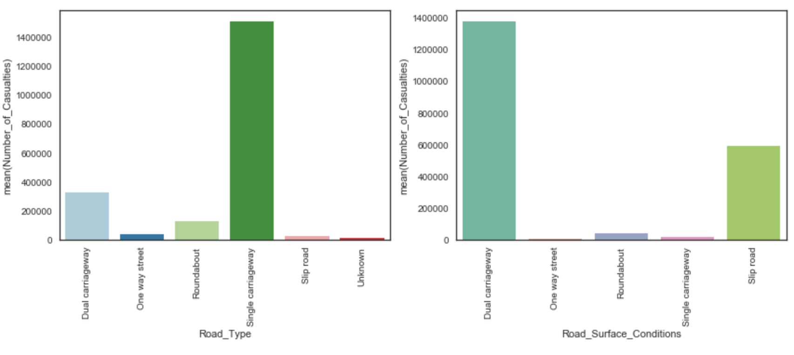
Exploratory Data Analysis
Question: What type and conditions of roads accidents frequently happen?

Slide 9
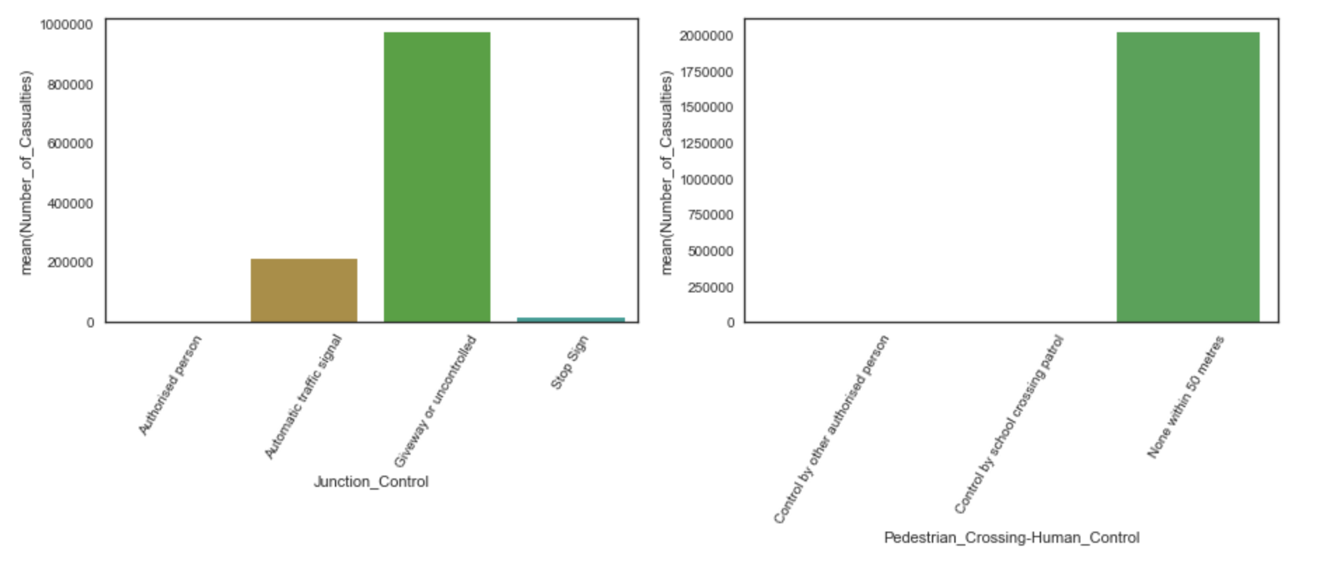
Exploratory Data Analysis
Question: In what junction control and pedestrian crossing human control most accidents happen?

Slide 10
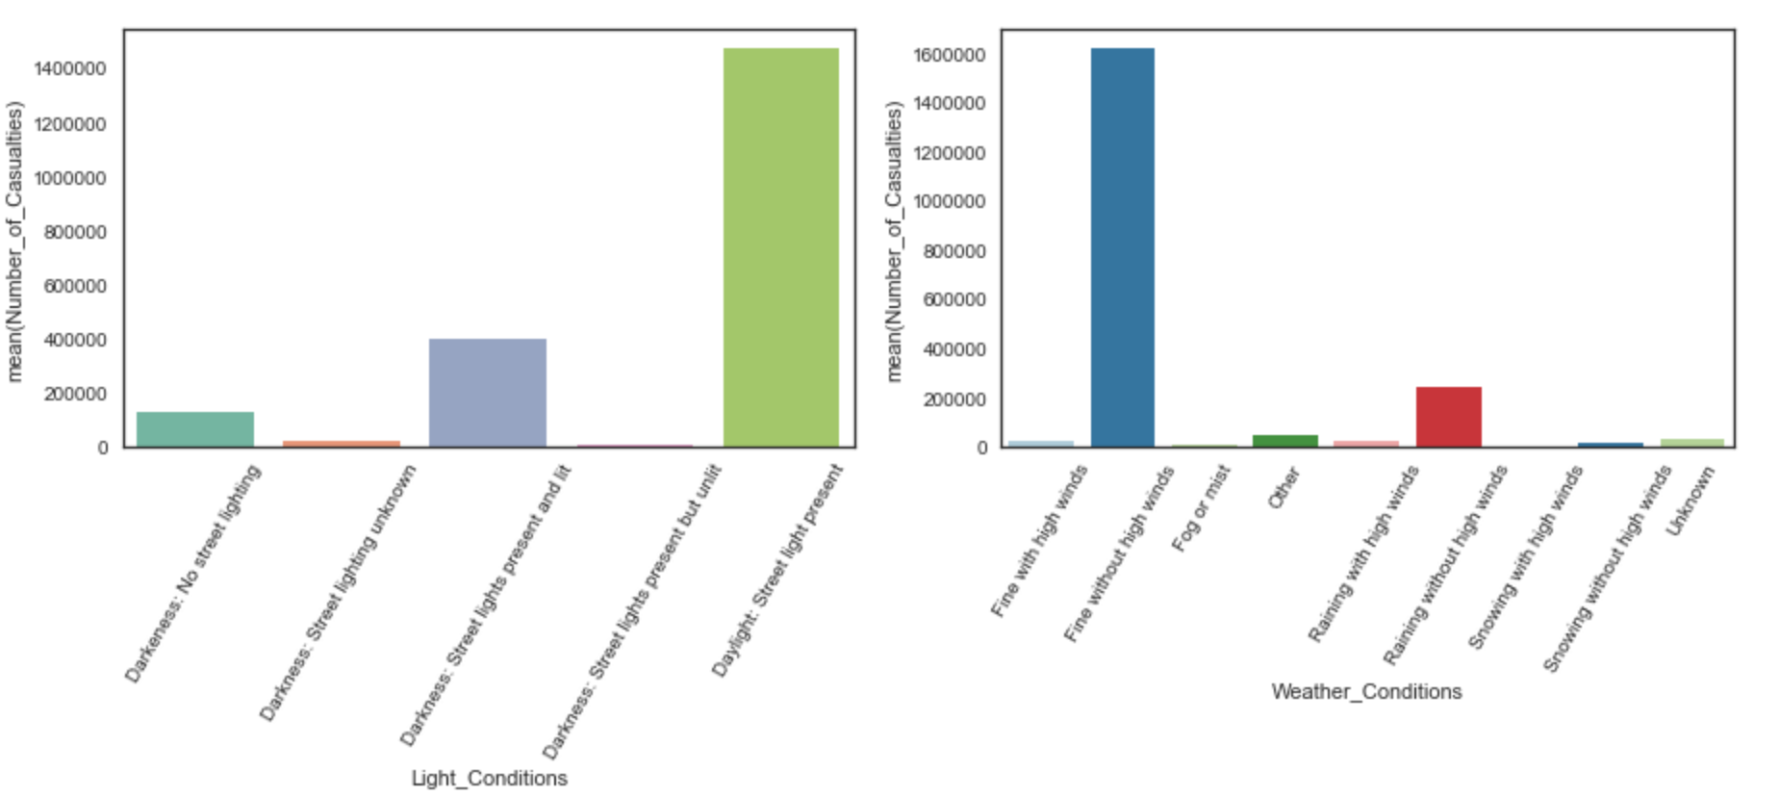
Exploratory Data Analysis
Question: In what light and weather conditions most accidents happen?

Slide 11
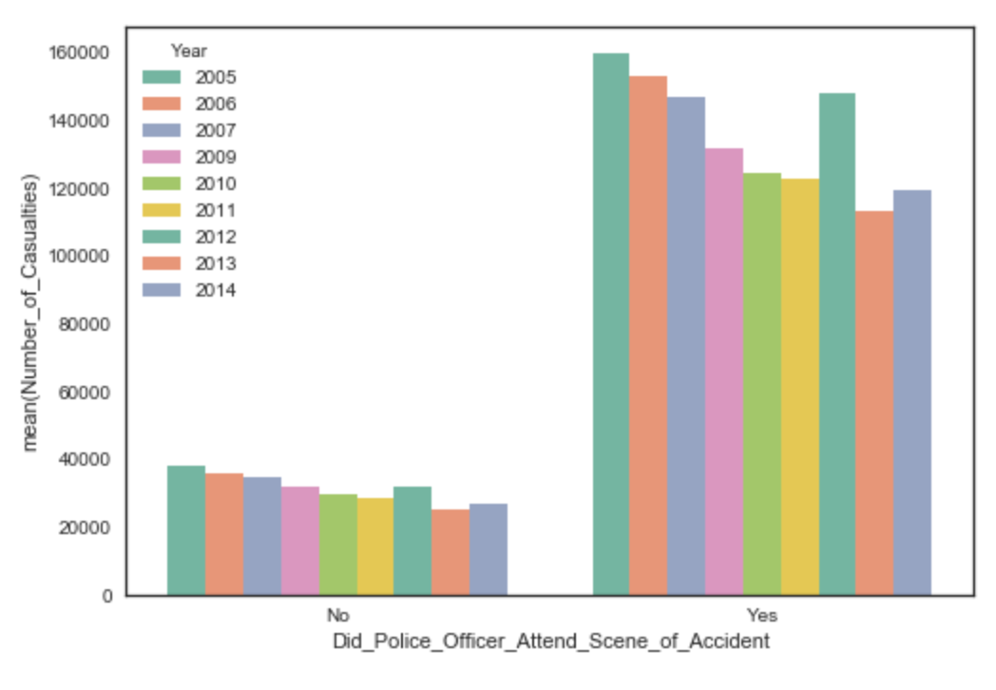
Exploratory Data Analysis
Question: How many accidents in every year police officers attended the scene of accident?

Slide 12
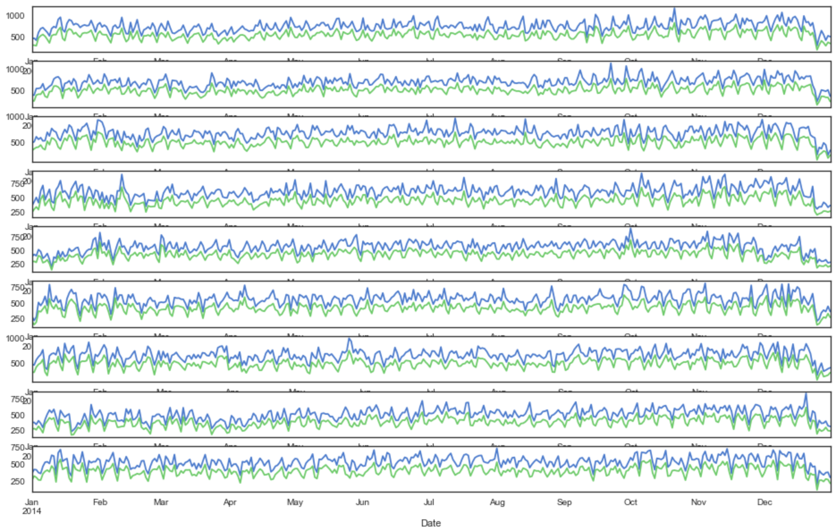
Exploratory Data Analysis
Question: Can we see pattern on the number of casualties happening every day in a yearly cycle?

Slide 13
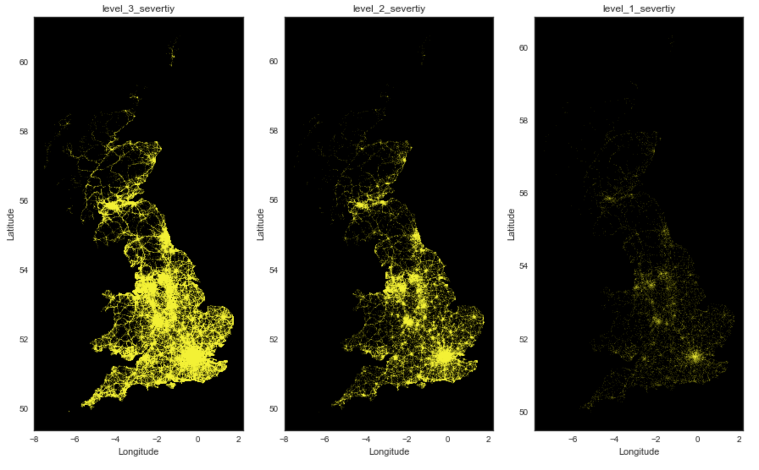
Exploratory Data Analysis
Question: What is the spread of different kinds of accidents across the nation?

Slide 14
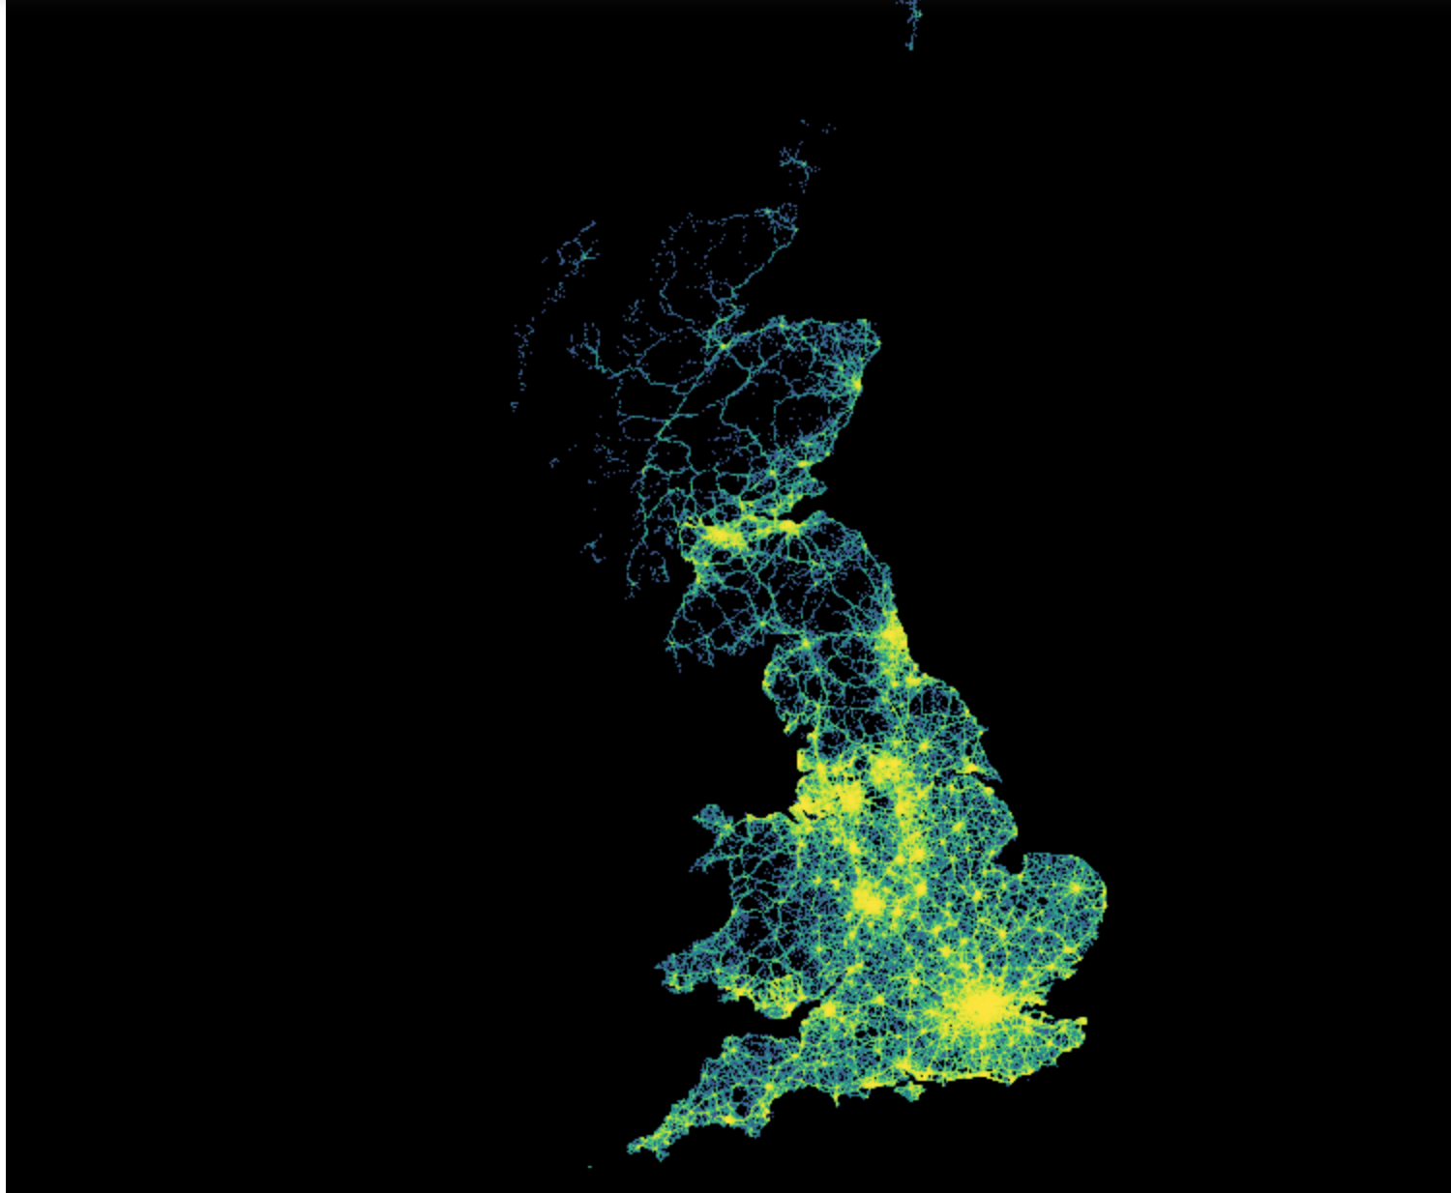
Traffic Accident Density

Slide 15
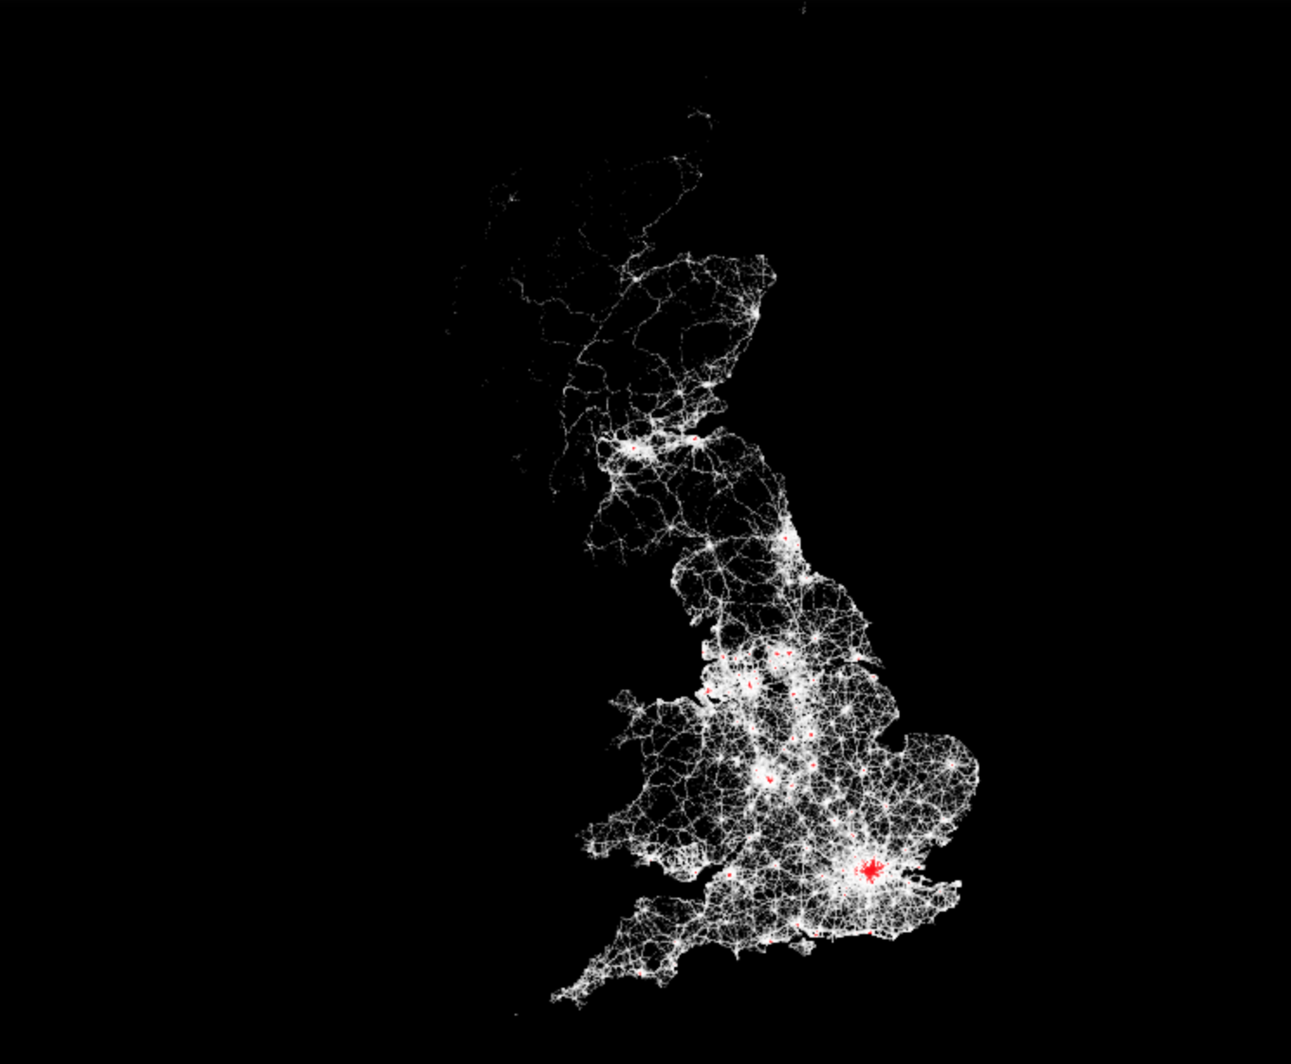
Top 1 Traffic Accidents
Observation: we can clearly see the top 1% of accidents reported occur in these major cities:
England: London, Birmingham, Liverpool, Manchester, Leeds, Newcastle, Noriwch, and Bristol
Wales: Cardiff
Scotland: Edinburgh, Glassgow, Aberdeen

Slide 16
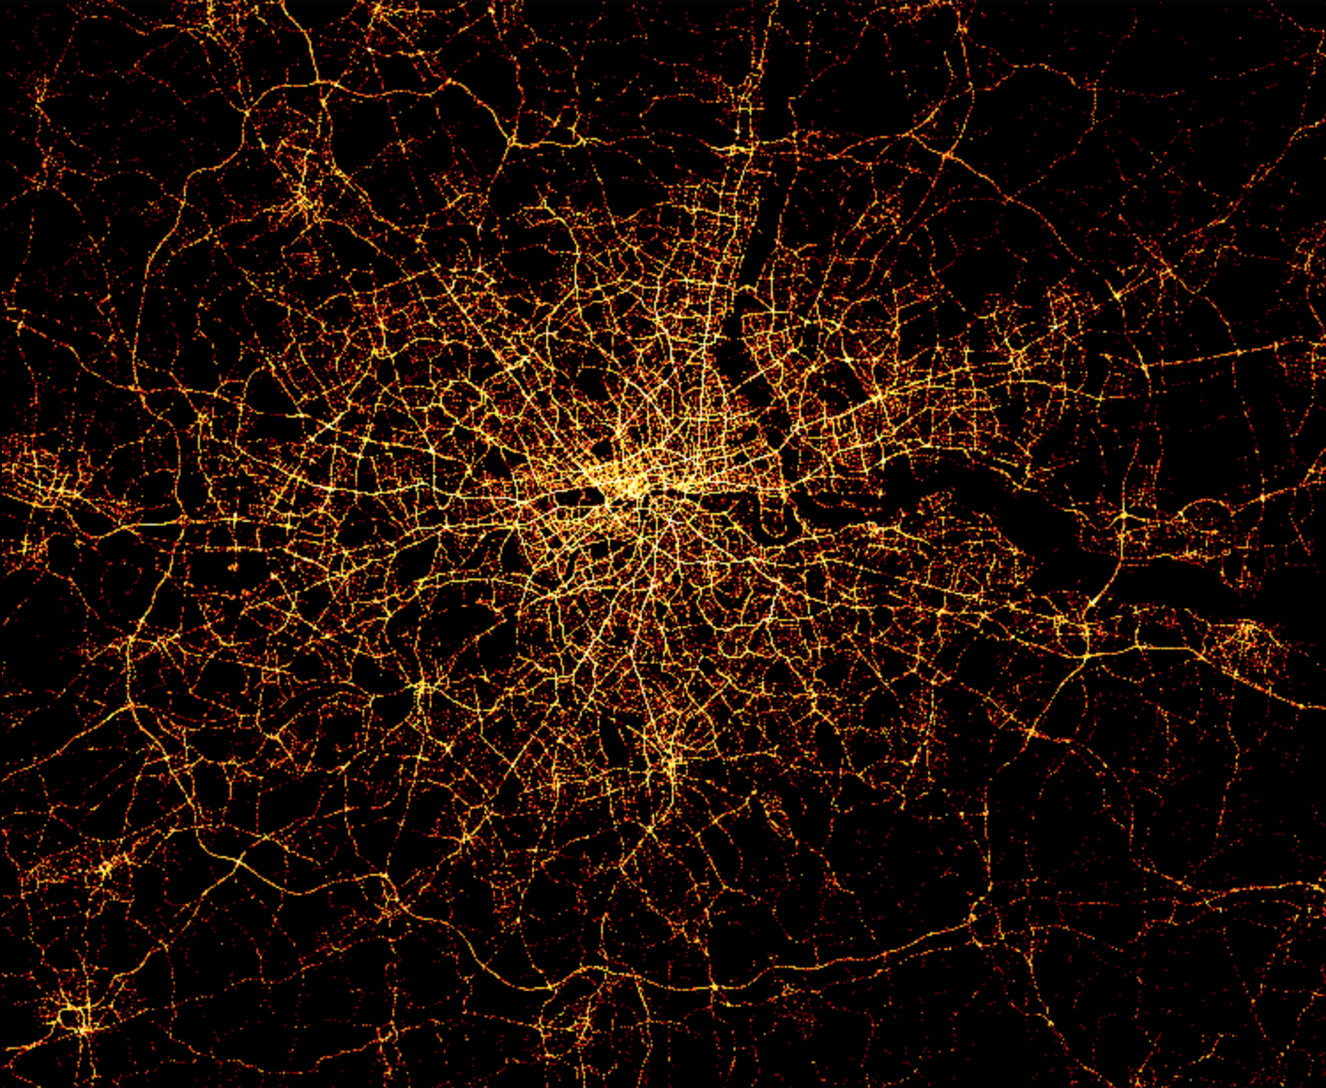
Traffic Accident Density In London Area

Slide 17
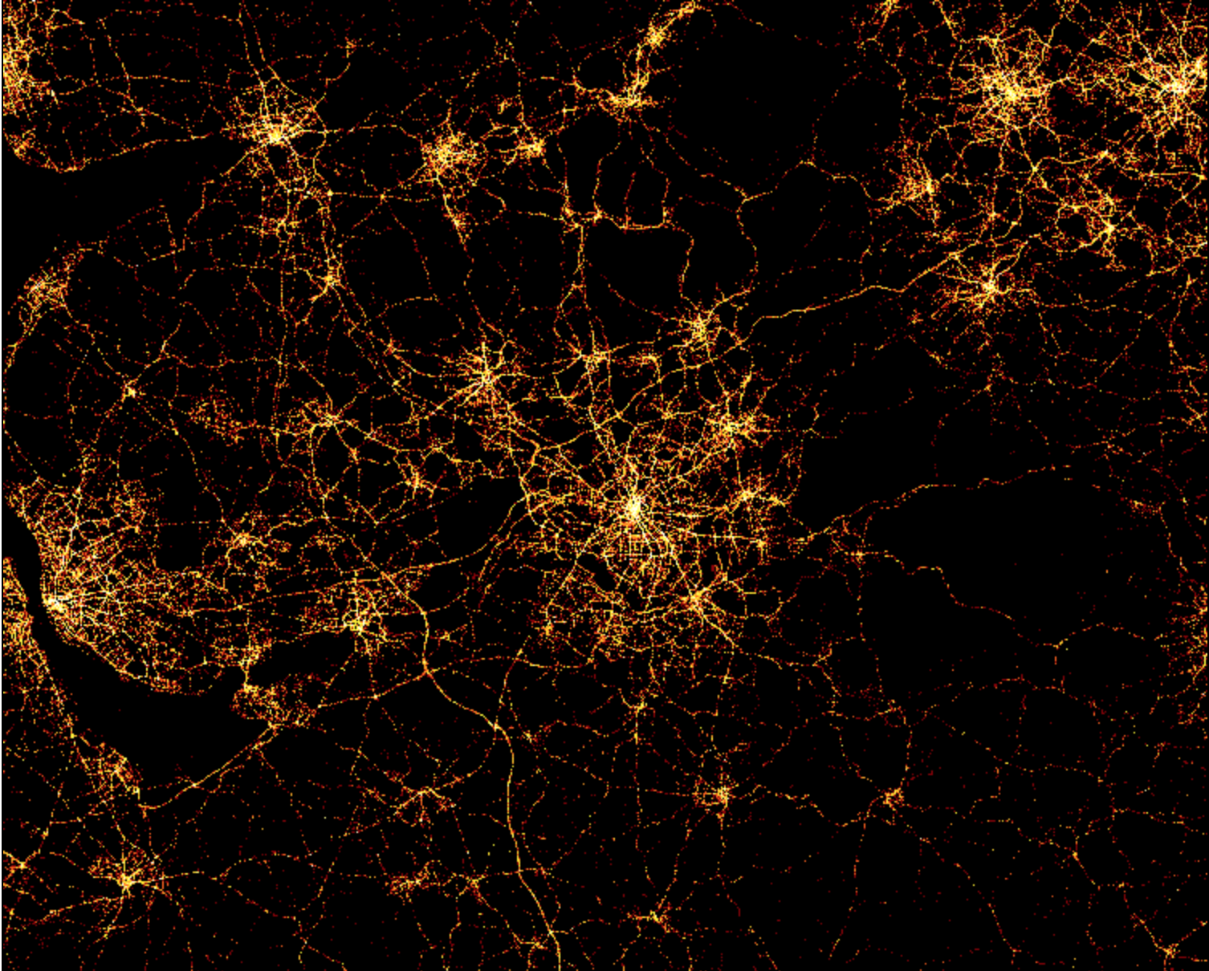
Traffic Accident Density In Manchester Area

Slide 18
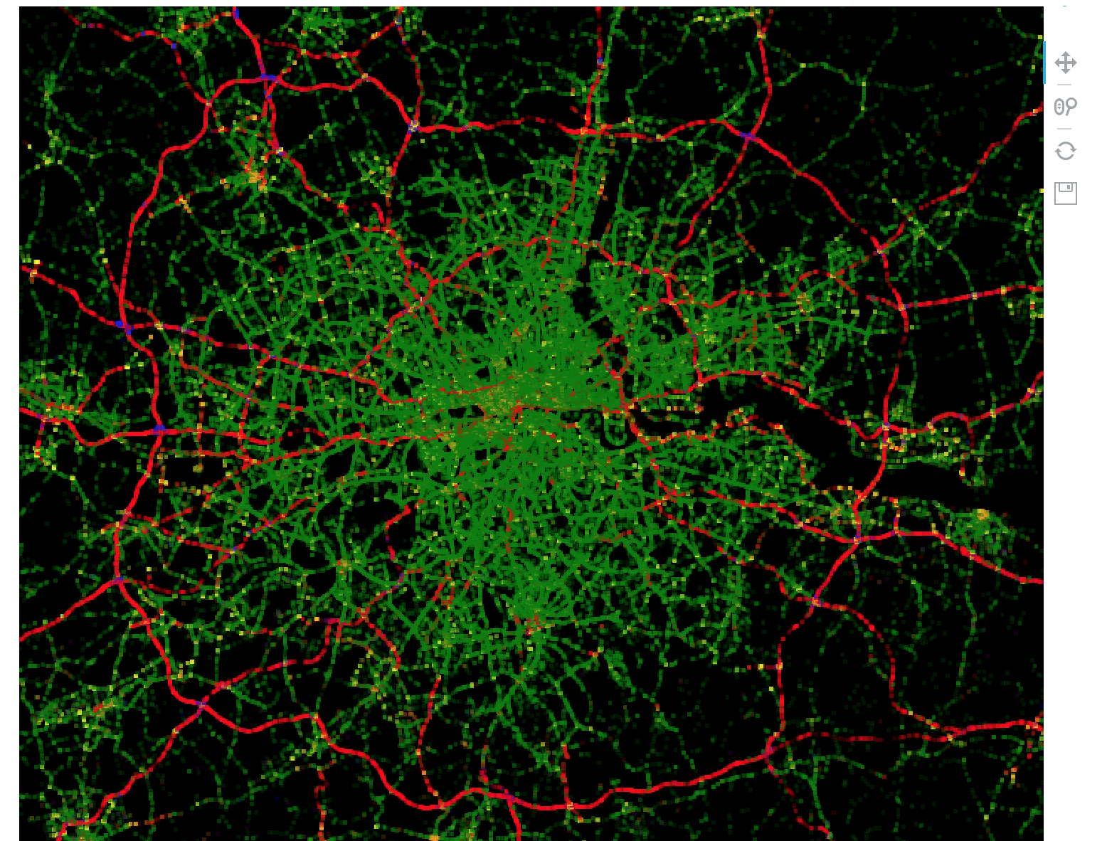
Traffic Accident Density Based on Road Type In London (Interactive)
'Dual carriageway':'red'
'One way street':'orange',
'Roundabout':'yellow',
'Single carriageway':'green'
'Slip road':'blue'
'Unknown':'purple'

Slide 19
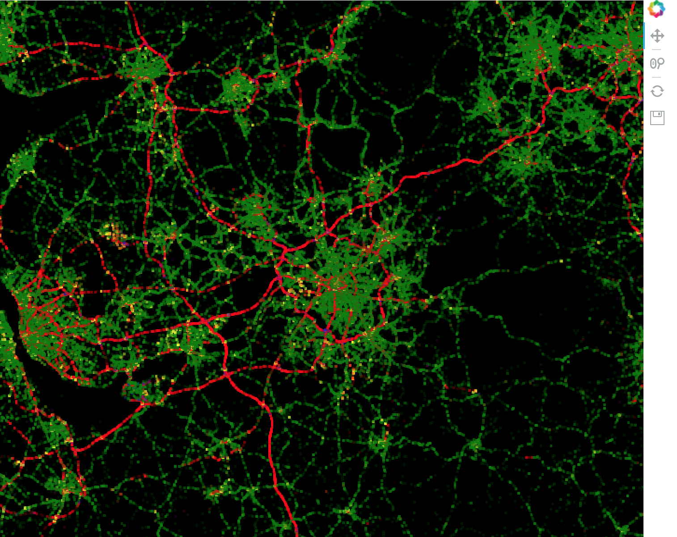
Traffic Accident Density Based on Road Type In Manchester (Interactive)

Slide 20
Predicting Number of Casualties
Steps: 1. Remove ‘Junction_Detail’ column because these are all None.
2. Binarize all categorical columns.
3. For easy modeling, drop rows will Null values in any of its columns. Consider interpolation on dealing with this data again.
4. Feature Set:
['Location_Easting_OSGR', 'Location_Northing_OSGR', 'Longitude',‘'Latitude', 'Police_Force', 'Number_of_Vehicles', 'Local_Authority_(District)','1st_Road_Number','Speed_limit','2nd_Road_Number','Year','month','day_of_month','day_of_year', 'hour', 'Local_Authority_(Highway)_XXXXXXXX, 'Road_Type_Dual XXXX, 'Junction_Control_XXXXX', 'Pedestrian_Crossing-Human_Control_XXXX','Pedestrian_Crossing-Physical_Facilities_XXXX', 'Light_Conditions_XXXX','Weather_Conditions_XXXX','Road_Surface_Conditions_XXXX','Did_Police_Officer_Attend_Scene_of_Accident_No', 'Did_Police_Officer_Attend_Scene_of_Accident_Yes','Urban_or_Rural_Area_1','Urban_or_Rural_Area_2', 'Accident_Severity_X, 'Accident_Severity_2', 'Accident_Severity_3', 'Day_of_Week_X', '1st_Road_Class_XXXX','2nd_Road_Class_XXXX']

Slide 21
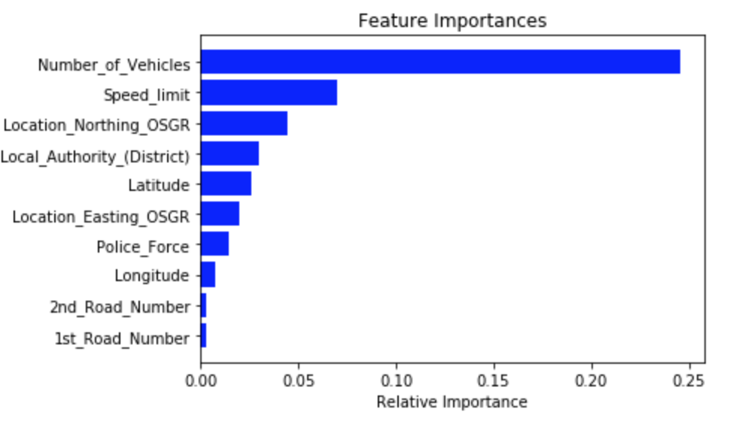
Predicting Number of Casualties
Regression Model | RMSE
Linear Regression | 0.72
XGBoost | 0.72

Slide 22
Predicting Latitude of the Accident
Steps: 1. Remove ‘Junction_Detail’ column because these are all None.
2. Binarize all categorical columns.
3. For easy modeling, drop rows will Null values in any of its columns. Consider interpolation on dealing with this data again.
4. Remove all features having some details on the location of the accident.
4. Feature Set:
['Police_Force','Number_of_Vehicles', 'Number_of_Casualties', '1st_Road_Number', 'Speed_limit', '2nd_Road_Number','Year','month', 'day_of_month','day_of_year','hour','Road_Type_XXXX','Junction_Control_XXXX,'Pedestrian_Crossing-Human_Control_XXXX', 'Pedestrian_Crossing-Physical_Facilities_XXXX', 'Light_Conditions_Darkeness: XXXX', 'Weather_Conditions_XXXX', 'Road_Surface_Conditions_XXXX,'Did_Police_Officer_Attend_Scene_of_Accident_No' 'Did_Police_Officer_Attend_Scene_of_Accident_Yes', 'Urban_or_Rural_Area_1','Urban_or_Rural_Area_2', 'Accident_Severity_1','Accident_Severity_2','Accident_Severity_3', 'Day_of_Week_X','1st_Road_Class_X','2nd_Road_Class_X']

Slide 23
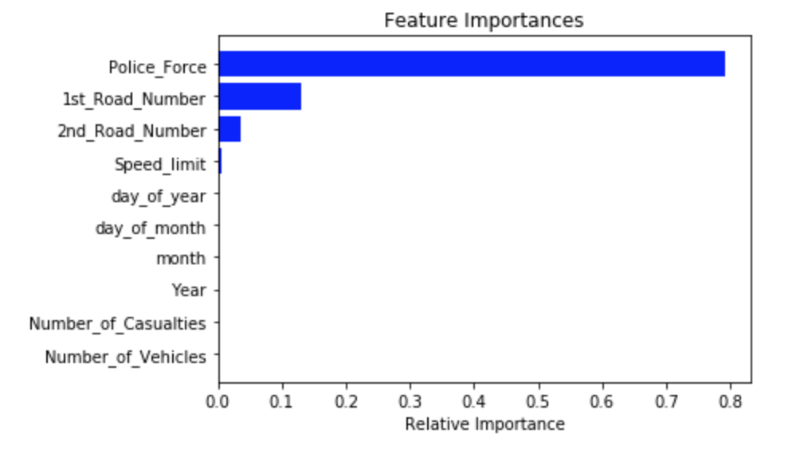
Predicting Latitude of the Accident
Regression Model | RMSE
Linear Regression | 0.95
XGBoost | 0.15

Slide 24
Predicting Longitude of the Accident
Steps: 1. Remove ‘Junction_Detail’ column because these are all None.
2. Binarize all categorical columns.
3. For easy modeling, drop rows will Null values in any of its columns. Consider interpolation on dealing with this data again.
4. Remove all features having some details on the location of the accident.
4. Feature Set:
['Police_Force','Number_of_Vehicles', 'Number_of_Casualties', '1st_Road_Number', 'Speed_limit', '2nd_Road_Number','Year','month', 'day_of_month','day_of_year','hour','Road_Type_XXXX','Junction_Control_XXXX,'Pedestrian_Crossing-Human_Control_XXXX', 'Pedestrian_Crossing-Physical_Facilities_XXXX', 'Light_Conditions_Darkeness: XXXX', 'Weather_Conditions_XXXX', 'Road_Surface_Conditions_XXXX,'Did_Police_Officer_Attend_Scene_of_Accident_No' 'Did_Police_Officer_Attend_Scene_of_Accident_Yes', 'Urban_or_Rural_Area_1','Urban_or_Rural_Area_2', 'Accident_Severity_1','Accident_Severity_2','Accident_Severity_3', 'Day_of_Week_X','1st_Road_Class_X','2nd_Road_Class_X']

Slide 25
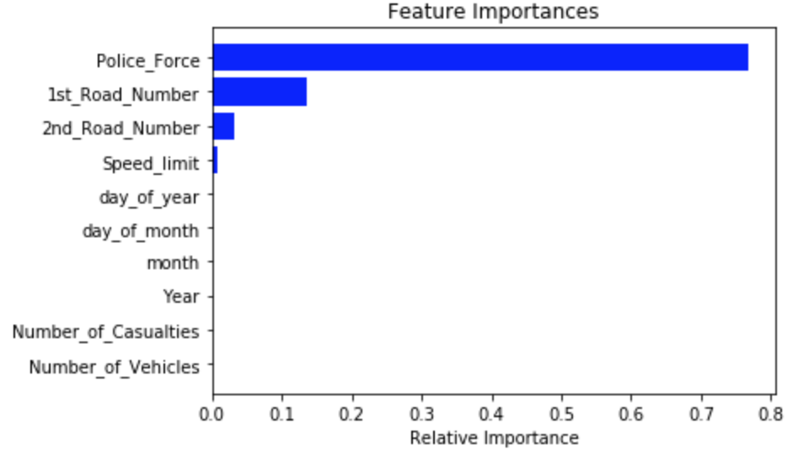
Predicting Longitude of the Accident
Regression Model | RMSE
Linear Regression | 1.19
XGBoost | 0.25

